Slide 1
Digital Portfolio
STUDENT NAME: B.Sadhana
REGISTER NO AND NMID: 212401027/
9A7097EB8614077A91044CBE056F4DB4
DEPARTMENT: Bachelor of Computer Applications
COLLEGE: COLLEGE/ UNIVERSITY: Prince shri venkateshwara Arts and Science college/ Madras University

Slide 2
PROJECT TITLE
Digital portfolio using front end development.

Slide 3


AGENDA
Problem Statement
Project Overview
End Users
Tools and Technologies
Portfolio design and Layout
Features and Functionality
Results and Screenshots
Conclusion
Github Link.
3/21/2024 Annual Review

Slide 4

PROBLEM STATEMENT
In this modern digital era, it is essential to showcase our skills digitally and attractively also effective to show our digital skills too.
The digital portfolio provides an interactive and accessible platform to present skills, achievements, projects and experiences.
It represents our skill digitally and provides ease reference and also quick access to your profile.

Slide 5

PROJECT OVERVIEW
This project involve creating a online collection of a person’s work, skills, and accomplishment.
Its primary goal to provide a easy accessible showcase that highlights a person’s potential and accomplishments.

Slide 6
What my portfolio contains:
Main objective:
To showcase my personal Qualification, achievements , skill , and projects
Profile picture
About Me
Education
Skills
Projects
Github link

Slide 7

WHO ARE THE END USERS?
Students
Job seekers
professionals
To highlight their degrees and projects.
To provide a interactive resume and their projects,
To showcase their about and the contribution on society and its developments and their Works.

Slide 8

TOOLS AND TECHNIQUES
HTML → Structure(pages, sections)
CSS → styling (colours, layouts, responsiveness).
JavaScript → Interactivity ( navigation menu)
Code editor : Visual Studio and hosting platform (Github pages).

Slide 9
POTFOLIO DESIGN AND LAYOUT
Sections included:
About Me
Education
Skills
Projects
Contact link
Responsive layout (mobile + desktop view).
9

Slide 10
FEATURES AND FUNCTIONALITY
Navigation Bar with smooth scrolling.
Project showcase with Images/details.
Interactive elements (animations).
Contact links.
Responsive design for all devices.

Slide 11

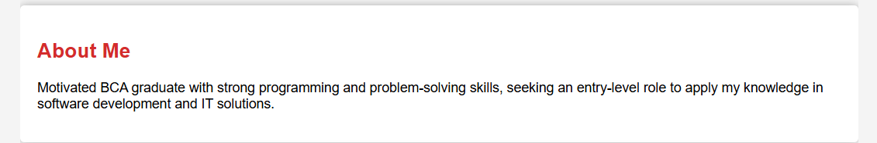
RESULTS AND SCREENSHOTS:
Final screenshot result:
About me →
3/21/2024 Annual Review
11

Slide 12
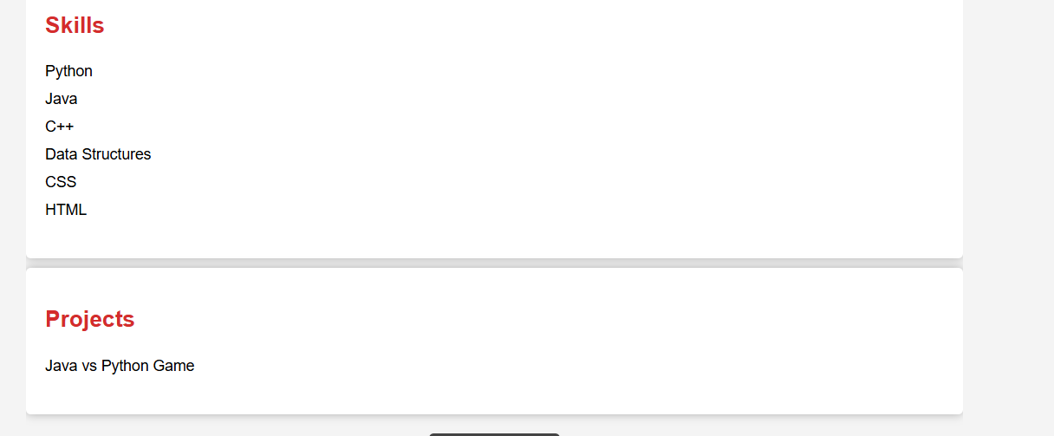
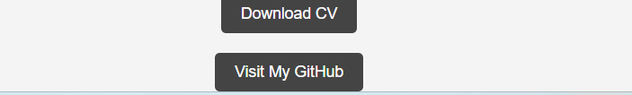
Skills and projects :
Contact links and CV :

Slide 13
CONCLUSION:
The digital portfolio contains smoother effects
It is of ease access and brief about someone
It provides digital links and easy communications
It is easy to browse about one’s experience , achievements , and projects details.
It is helpful for college students , job seekers , freelancers , enterprenurs , recruiters , and Hr’s to verify the profile easier and also effective.
Digital portfolio Makes things easier and very powerful tool to communicate.
13

Slide 14
Conclusions:
This digital portfolio is a tool to showcase their potential and their useful projects to society,
Anyone in society can use their own portfolios to express their work education projects experience and their contacts digitally.
It saves lot of time as specified information can only be viewed than viewing other unnecessary details.

Slide 15
GITHUB LINK
https://sadhana-creator.github.io/digital-portfolio/

Slide 16
THANK YOU ALL!
For your valuable time for this slide.
THANK YOU FOR YOUR VALUABLE TME

